Slide 1
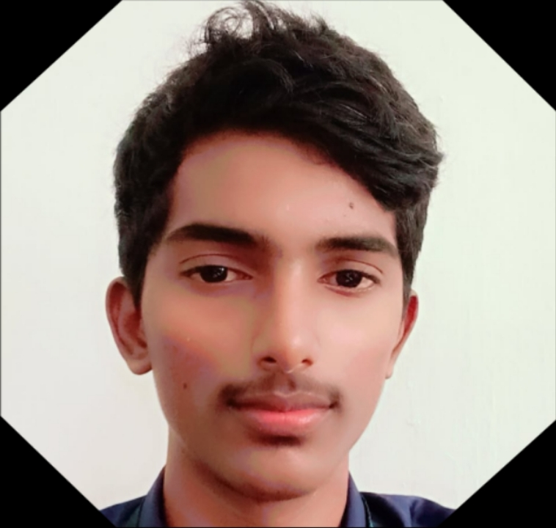
Digital Portfolio
STUDENT NAME: S.Nethran
REGISTER NO AND NMID: 31924U09018
DEPARTMENT: BCA
COLLEGE::Mazharul Uloom College
[Autonomous]/ Thiruvallur University

Slide 2
PROJECT TITLE
PERSONAL DIGITAL PORTFOLIO

Slide 3


AGENDA
Problem Statement
Project Overview
End Users
Tools and Technologies
Portfolio design and Layout
Features and Functionality
Results and Screenshots
Conclusion
Github Link
3/21/2024 Annual Review

Slide 4

PROBLEM STATEMENT
The “Problem Statement” in a project or research clearly defines the issue you are trying to solve. It sets the foundation for your study or project. Here’s the meaning explained in points:
Gives Context – Provides background information so the reader understands the situation.
Highlights Impact – Explains the negative consequences of not solving the problem.
Justifies the Need – Shows why solving this problem is important (social, technical, educational, environmental, etc.).

Slide 5

PROJECT OVERVIEW
A Project Overview is a short summary of the project that explains what it is about, why it is important, and how it will be carried out. It gives a clear idea of the project at a glance.
Project Title – The name of the project.
Introduction – A brief explanation of the topic or idea.
Overview of project – The name of the project digital portfolio and using the project overview.

Slide 6

WHO ARE THE END USERS?
End users are the final people who actually use a product, system, or service. They are different from developers, administrators, or intermediaries because they directly interact with the finished output.
In software development → End users are the people who install and use the app on their phone or computer.
In education technology → Students and teachers using a learning app are the end users.
In an e-commerce website → Shoppers buying products online are the end users.

Slide 7

TOOLS AND TECHNIQUES
IoT Hardware – Sensors (ultrasonic, weight), microcontrollers (Arduino/Raspberry Pi).
Software Platforms – Cloud services (ThingSpeak, Firebase), programming (C, Python).
Techniques
Real-time Monitoring – Wireless data transfer from bins to cloud/mobile app.
Automation & Alerts – Automatic notifications and optimized waste collection routes.

Slide 8
POTFOLIO DESIGN AND LAYOUT
Cover Page – Title, Name, Register Number, Department, College.
About & Project Details – Profile, Project overview, objectives, tools, and techniques.
Skills & Achievements – Technical skills, certifications, and strengths.
Conclusion & Contact – Future scope, summary, and contact details.
8

Slide 9
FEATURES AND FUNCTIONALITY
Real-time Monitoring – Sensors track waste level in bins.
Automatic Alerts – Notifications sent when bins are full.
Data Visualization – Dashboard/app shows waste status and reports.
Optimized Collection – Route planning for efficient garbage pickup.

Slide 10

RESULTS AND SCREENSHOTS
Result: I was successfully designed the digital portfolio project
Student Information
Academic Details
Projects and Achievements
Skills and Tools
Contact Information
Screenshot
(Here you can add the screenshot of your digital portfolio interface. For example:)
Homepage Screenshot
About Me Section Screenshot
Project Showcase Screenshot
Contact Page Screenshot
3/21/2024 Annual Review
10

Slide 11
CONCLUSION
The Digital Portfolio Project serves as a structured platform to showcase my academic details, technical skills, and project work in a professional manner. It highlights my abilities, achievements, and practical knowledge through a well-organized layout. This portfolio not only reflects my learning journey but also acts as a reference for future career opportunities and personal growth.
11

